Slide 1
Project-10 Custom-Object Character Recognition(OCR) on AWS
Submitted by:
Arjun singh Solanki
Mail-id – arjunsingh.eee11@gmail.com
Github – https://github.com/Arjunssolanki

Slide 2
Introduction
In this project custom OCR system combines YOLO_V5 and Tesseract to efficiently extract and digitize data from lab reports.
YOLO_V5, trained on a personalized dataset, detects key elements like test names, values, units, and reference ranges by identifying bounding boxes.
These regions are then passed to Tesseract for text extraction, converting the unstructured content into editable digital files.
This solution improves accuracy and efficiency in handling medical data, streamlining lab report management.

Slide 3
Workflow Overview
Step 1: Label images using LabelImg (Test Name, Value, Units, Reference Range).
Step 2: Split the dataset into training and testing sets.
Step 3: Train YOLO_V5 model in Google Colab for object detection.
Step 4: Use YOLO_V5 to detect key regions in lab reports.
Step 5: Extract text using Tesseract OCR.
Step 6: Build a Streamlit app for user interaction and testing.

Slide 4
Step 1 - Labeling Images
Tool Used: LabelImg
Lab report images in the data_images folder were labeled using LabelImg, marking key elements like Test Name, Value, Units, and Reference Range with bounding boxes for YOLO_V5 model training.

Slide 5
Step 2 - Data Preparation
Import necessary libraries for file handling, XML parsing, and data processing.
Extract paths of XML files from the data_images folder.
Define a function to parse XML files, extracting filenames, image dimensions, and bounding box coordinates.
Process and combine the extracted data into a structured pandas DataFrame.
Compute normalized coordinates for the center, width, and height of the bounding boxes.
Split the dataset into 80% training and 20% testing based on unique filenames.
Encode the labels for detected objects (Test Name, Value, Units, Reference Range).
Create directories for training and testing images.
Move images to train/test folders and save corresponding label files in .txt format.
Note: This process was implemented in the 01_extract_text_from_xml.ipynb file.

Slide 6
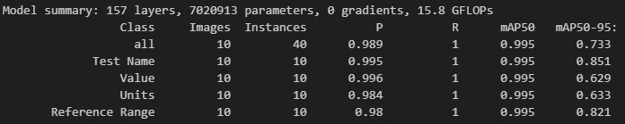
Step 3 - Model Training
Environment: Google Colab
Model use: https://github.com/ultralytics/yolov5.git (file: model training/model_training.ipynb)
Command to train model:
!python train.py --data data.yaml --weights runs/train/Model2/weights/best.pt --img 640 --batch-size 2 --name Model --epochs 200
Model summary:
Interpretation:
The performance metrics show high precision (P), recall (R), and mean Average Precision (mAP50) across all classes, with mAP50-95 reflecting overall detection accuracy at varying IoU thresholds, indicating strong model performance, especially for Test Name and Reference Range.

Slide 7
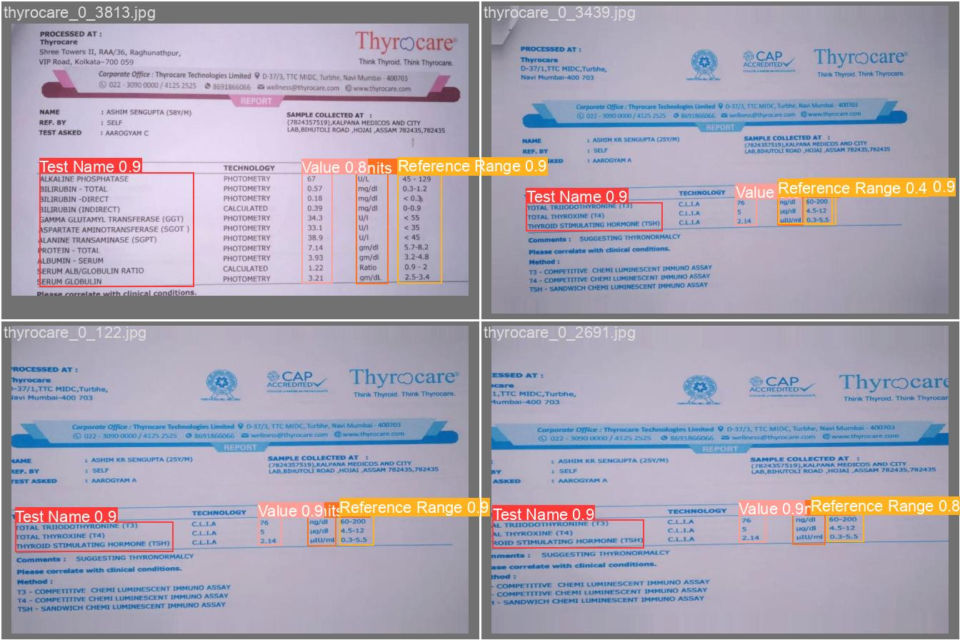
Step 4 - Object Detection with YOLO_V5

Slide 8
Code Description
Navigate to the Directory :cd path/to/your/prediction
Run the file : python prediction.py
The code implemented in the prediction.py file performs object detection using a YOLO model with the following key steps:
Load YAML Configuration: It loads a YAML file (data.yaml) containing label names for the detected objects.
Initialize YOLO Model: The YOLO model is loaded from an ONNX file (best.onnx), setting the preferable backend and target for inference using OpenCV.
Image Preprocessing: An image (testimage.jpg) is read, and if it's not square, it is padded to create a square input image, which is a requirement for the YOLO model.
Image Resizing: The image is resized to 640x640 pixels (as required by YOLO), and a blob is created for input to the model.
Make Predictions: The model performs inference to generate predictions for the input image.
Non-Maximum Suppression (NMS): The code filters out low-confidence detections and applies NMS to eliminate redundant bounding boxes, keeping only the most confident predictions.
Draw Bounding Boxes: For each detected object, the bounding box is drawn on the original image, along with the class label and confidence score.
Save Results: Finally, the annotated image is saved as “testimage_model6_prediction.jpg”
Overview:
This process allows for efficient and effective detection of specified objects within an image, visualizing the results clearly.

Slide 9
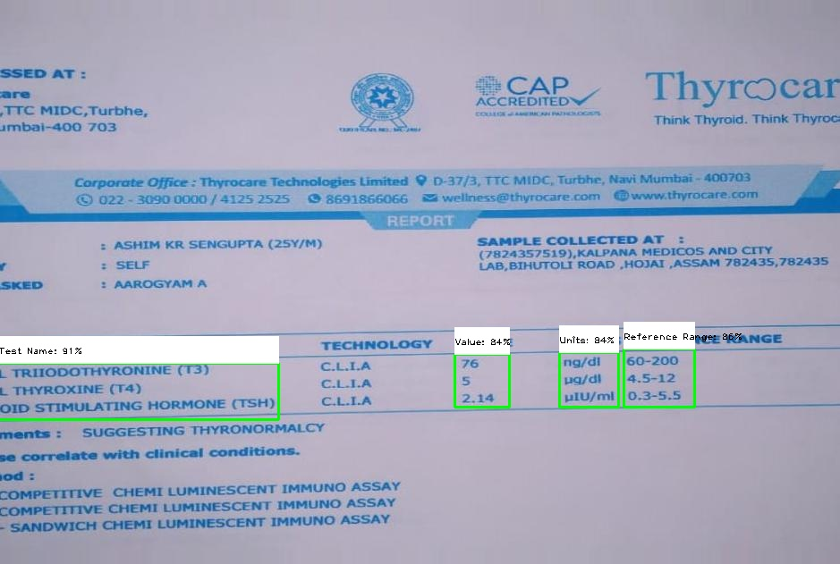
Output:

Slide 10

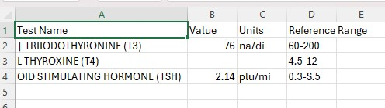
Step 5 - Text Extraction with Tesseract

Slide 11
Code Description
Navigate to the Directory :cd path/to/your/prediction
Run the file : python main.py , Enter the path of the JPG image file
The main.py script utilizes a YOLO model for object detection in images and applies Optical Character Recognition (OCR) to extract text from the detected regions. It processes the image, predicts bounding boxes, performs OCR on these crops, and saves the results to a CSV file while also creating an annotated image.
Process
Load YOLO Model: The YOLO model is loaded using OpenCV's DNN module, setting the backend and target to CPU for compatibility.
Image Preparation: The input image is resized to create a square image suitable for YOLO, and a blob is created for prediction.
Make Predictions: The YOLO model predicts objects in the image, returning detection scores, class IDs, and bounding box coordinates.
Filter Predictions: Detected objects are filtered based on confidence scores, and Non-Maximum Suppression (NMS) is applied to eliminate overlapping boxes.
Perform OCR: Optical Character Recognition is applied to each detected object’s bounding box to extract relevant text, organized into a structured format.
Save Results to CSV: The extracted text data is saved to a CSV file, with columns organized based on the detected fields.
Draw Bounding Boxes: Bounding boxes are drawn around detected objects in the original image, which is then saved as an annotated image.

Slide 12
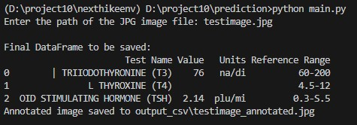
Terminal Output

Slide 13
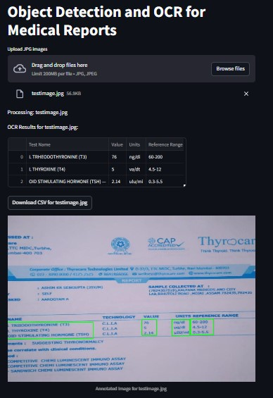
Step 6 - Deployment with Streamlit

Slide 14
Code Description
Navigate to the Directory :cd path/to/your/prediction
Run the Streamlit App : streamlit run app.py
Purpose: The app performs object detection and Optical Character Recognition (OCR) on uploaded JPG images of medical reports to extract relevant information.
User Interface: It features an intuitive interface where users can upload one or multiple JPG images for processing.
Model Integration: The app integrates a YOLO (You Only Look Once) model for object detection, allowing for accurate identification of specific fields within the medical reports.
Data Extraction: Using Tesseract OCR, the app extracts text from detected regions, organizing it into structured data such as "Test Name," "Value," "Units," and "Reference Range.“
Output Options: Users can view the extracted data in a table format and download the results as a CSV file, along with a visual display of the images annotated with bounding boxes around detected regions.

Slide 15
Conclusion
This project developed an object detection and OCR application for extracting key information from medical reports. Utilizing the YOLO model and Tesseract, the application accurately identifies test names, values, units, and reference ranges from JPG images. The Streamlit interface allows users to easily upload images, view annotated results, and download structured data in CSV format. This tool enhances efficiency and accuracy in managing medical records, paving the way for further improvements, such as supporting additional formats and enhancing data validation.

